Slide 1
Sales KPI Analysis

Slide 2
Table of Contents
Collection of Sales data
Aggregations and visualization of Data
Dashboard
Overview of Sales Data
Sales Performance or Sales Insight
Conclusion
Recommendations

Slide 3
1. Collection of Sales Data

Slide 4
Total Revenue Data in Each Year
Row Labels | Sum of OrderValue
2019 | 121683482
2020 | 164896672
2021 | 230274704
2022 | 248587099
Grand Total | 765441957

Slide 5
Percentage of Total Revenue Year Wise Data
Row Labels | Sum of OrderValue
2019 | 15.90%
2020 | 21.54%
2021 | 30.08%
2022 | 32.48%
Grand Total | 100.00%

Slide 6
Sum of sales by Category Data
Sum of OrderValue | Column Labels
Row Labels | Accessories | Casing | Lighting | Pipes | Switches | Switchgear | Wires | Grand Total
2019 | 59119688 | 15209927 |  | 24748378 | 14987878 |  | 7617611 | 121683482
2020 | 75453090 | 23965550 |  | 36293033 | 20858895 | 133746 | 8192358 | 164896672
2021 | 95721569 | 31979338 |  | 67467093 | 20133124 | 1083689 | 13889891 | 230274704
2022 | 102308497 | 32528024 | 355599 | 73425175 | 19317457 | 3183705 | 17468642 | 248587099
Grand Total | 332602844 | 103682839 | 355599 | 201933679 | 75297354 | 4401140 | 47168502 | 765441957

Slide 7
Data of Top 10 Average Revenue/Customers
Row Labels | Average of OrderValue
C01-0002 | 49298.75758
C01-0003 | 73420.69231
C06-0003 | 38089.86667
C06-0015 | 34913
C27-2435 | 47027.39362
C27-2707 | 124844.3077
C27-3099 | 88356
C27-3612 | 58078
C29-0134 | 36961.83333
C29-0241 | 58779
Grand Total | 53527.10811

Slide 8
Top 10 Sale State
Sum of OrderValue | Column Labels
Row Labels | 2019 | 2020 | 2021 | 2022 | Grand Total
Bihar | 1639602 | 1639302 | 1233945 | 6346531 | 10859380
Chhattisgarh | 2675855 | 2774240 | 1782029 | 3034531 | 10266655
Gujarat | 9289399 | 12455196 | 16592595 | 15506849 | 53844039
Jharkhand | 7062151 | 7840625 | 7805030 | 11449145 | 34156951
Karnataka | 4126263 | 6301907 | 7937702 | 7342078 | 25707950
Madhya Pradesh | 12878099 | 17448579 | 20784599 | 18519723 | 69631000
Maharashtra | 55859345 | 78449722 | 119867941 | 123927205 | 378104213
Odisha | 5445347 | 11355849 | 21184024 | 23628060 | 61613280
Tamil Nadu | 6867918 | 8653055 | 10841289 | 12719781 | 39082043
Uttar Pradesh | 7773188 | 9983006 | 12268163 | 15714686 | 45739043
Grand Total | 113617167 | 156901481 | 220297317 | 238188589 | 729004554

Slide 9
Top 10 Count of Customers
Row Labels | Count of OrderValue
C21-0006 | 3516
C23-0006 | 7188
C24-0007 | 4828
C24-0010 | 3845
C24-0079 | 4367
C27-0052 | 3412
C27-0207 | 7097
C27-0376 | 8802
C27-0416 | 6303
C33-0068 | 4841
Grand Total | 54199

Slide 10
2. Aggregations and visualization of Data

Slide 11
Maximum and Minimum Revenue

Slide 12
Revenue Generate

Slide 13
Profit % of Total Revenue

Slide 14
Sum of Sales by Category

Slide 15
Top 10 Average Revenue/Customers

Slide 16
Top 10 State

Slide 17
Top 10 Count of Customers

Slide 18
3.Dashboard

Slide 19
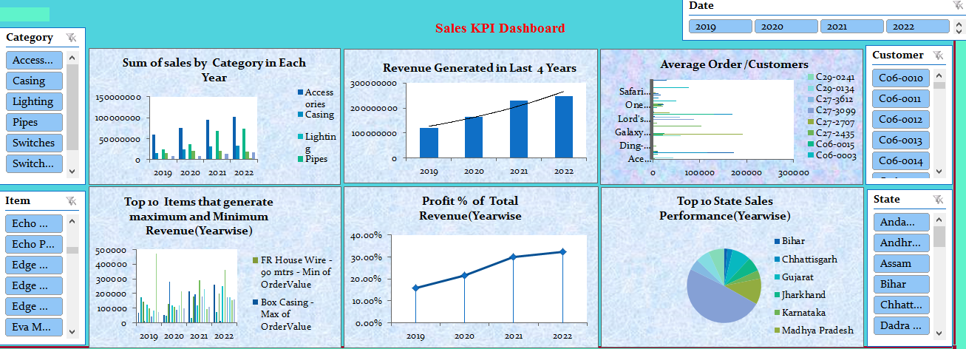
Sales KPI Analysis Dashboard

Slide 20
4. Overview of Sales Data
By using VLOOKUP functions we combined all the dataset entity by matching column data.

Slide 21
5. Sales Performance or Some Insights
Comparison of Sales Data
Total Revenue vs Items
Highest Revenue generated item is HMS-Pipe(Consistently Increased sales growth percentage over the years)
Lowest Revenue generated item is FRLSH House wire(Sales growth percentage is very low over the years)
Revenue generated of all other items are gradually up and down over the years.

Slide 22
Total Revenue vs Category
Highest Revenue generated category is Accessories(Consistently increased sales growth over the years).
Lowest Revenue generated category is Switchgear.
Most of the category was not introduced in 2019 but in next year it was launched .The sales of Switches fall down up to 4%. Percentage of sales Growth is not at the same level compared to the 2022 year.
Company required to have a proper analysis to achieve its target Customers and satisfying their customers needs to supply best items in terms of Quality.

Slide 23
Total Revenue vs State
Highest Revenue generated State is Maharashtra.
Lowest Revenue generated State is Mizoram.
Company mainly focuses on loss making states like Manipur, Mizoram, Nagaland etc. where less revenue is generated gradually per year. Company needs to analyze the reason behind less sales in West Bengal, Punjab, Delhi, Kerala etc.
Company have to take immediate steps to increase Turnover and convert them into Profit making States.

Slide 24
6. Conclusion
From the above graph, we concluded that total revenue generated in each year gradually increases but some deflection(up and down) happens in items in each year.
In category graph, there will be new category added in each respective years. Therefore it will impact the revenue generated in each year. Sales of Lighting is not up to mark. Company needs to identify the root cause for low Demand of the category.

Slide 25
7. Recommendations
Percentage of revenue is considerably rising since last four years But growth percentage of item is not up to the marks most probably because of some covid criteria and less demand of the particular items in the market or some big competitors (on the same items in the market) so that demand of that particular item gradually varies .
To overcome this problem to study the market what exact product or item are captured right now in the market and a customer can used in their life on day to day basis, lower cost that a common customers can afford Therefore average order per customers on each year by giving them some coupon discounts or give any offers it will also impact our sales revenue.
In the Current year percentage of Growth rate is reduced to 7.17% from 39.65% which is 32.48% downfall compared to growth rate of previous Year. Company needs to be more focuses on the quality of Products to maintain its growth rate and its durability. From the graph the product seems to be in the maturity stage of Product Life Cycle. If Company doesn’t take desired steps the profit may start falling and results in closure of Company.

Slide 26
Thank You

